Slide 1

Stock Price Analysis
Michael Chiang (mtc166)

Slide 2
The Question
Can a machine learning model accurately predict the effects of an economic downturn?

Slide 3
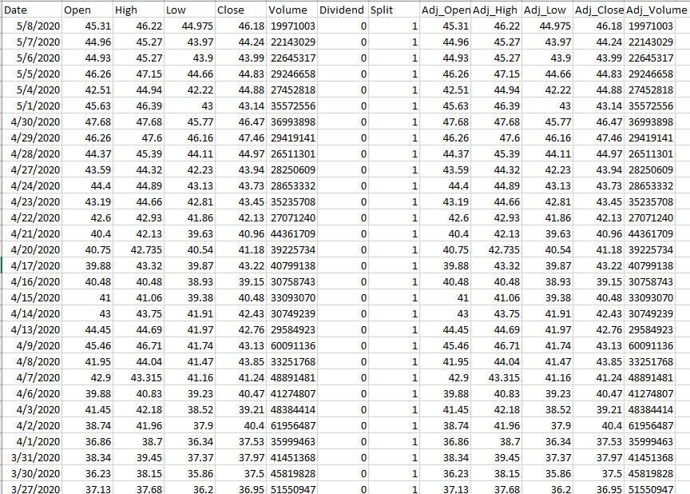
Data Set Used
Top 50 of the Fortune 500 companies of 2019
Data was acquired from Quandl
Data includes open, high, low, and close prices as well as adjusted ones
Sample data of Exxon Mobil’s historical stock prices

Slide 4
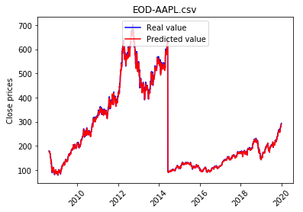
Results
Initial models showed very high accuracy due to the labels used

Slide 5
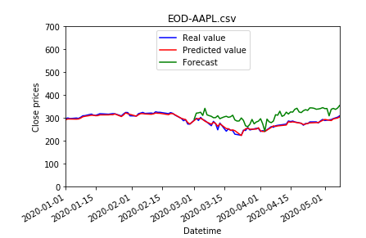
Results (cont.)
When it came to forecasting, the model showed values that were generally higher than the actual result
Forecasted early 2020 prices to present to judge the effects of COVID 19
The mean error can be applied when the knowledge of the next crisis is known in order to get the worst case scenario prices

